Slide 1

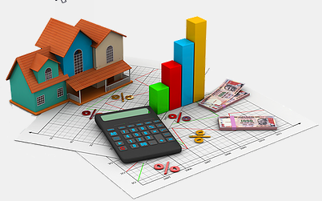

Capstone Project
HOUSE PRICE PREDICTION
A tool to predict the cost of the house based on different features that helps a buyer find the perfect match and a seller sell in the right price. This tool works like a real estate agent without the brokerage being incurred and offering the best deals to both the parties.

Slide 2
Flow of the presentation
Introduction to the Business Problem – Data & Around the Data
Understanding the Business Problem – Objective, Scope & Constraints
Exploratory Data Analysis Summary
Data Transformation and Assumptions
Modelling – Building and Tuning
Business Recommendations

Slide 3
Introduction to the business problem
THE VALUE OF A HOUSE JUST CANNOT BE DEFINED IN CURRENCY .
REAL ESTATE INDUSTRY IS ONE OF THE MOST UNPREDICTABLE INDUSTRY WHICH NEEDS TO BE KEPT IN CHECK.
THE PRICE OF THE HOUSE IS NOT JUST THE LOCATION AND THE SIZE OF PROPERTY, LOT OF OTHER FEATURES ALSO CONTRIBUTE IN DEFINING THE ACTUAL COST.
BUYING A HOUSE BY NOT OVER-PAYING AND SELLING THE HOUSE AT THE RIGHT PRICE NEEDS NO SKILL ANYMORE, WHY PAY A BROKERAGE WHEN WE ARE HERE ?

Slide 4
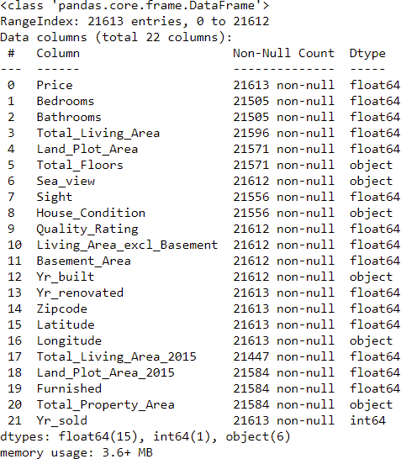
About the data and around the data
The data provided to us are of over 21600 houses that have been sold in 2014-2015 in King County, Washington. We have been provided with over 20 features and not just the property sizes
Almost 29% of Washington’s population i.e Around 2.29 Million Residents resides in King County (as per Wikipedia and kingcounty.gov)
So it indeed is a big market for real estate to thrive and flourish.

Slide 5
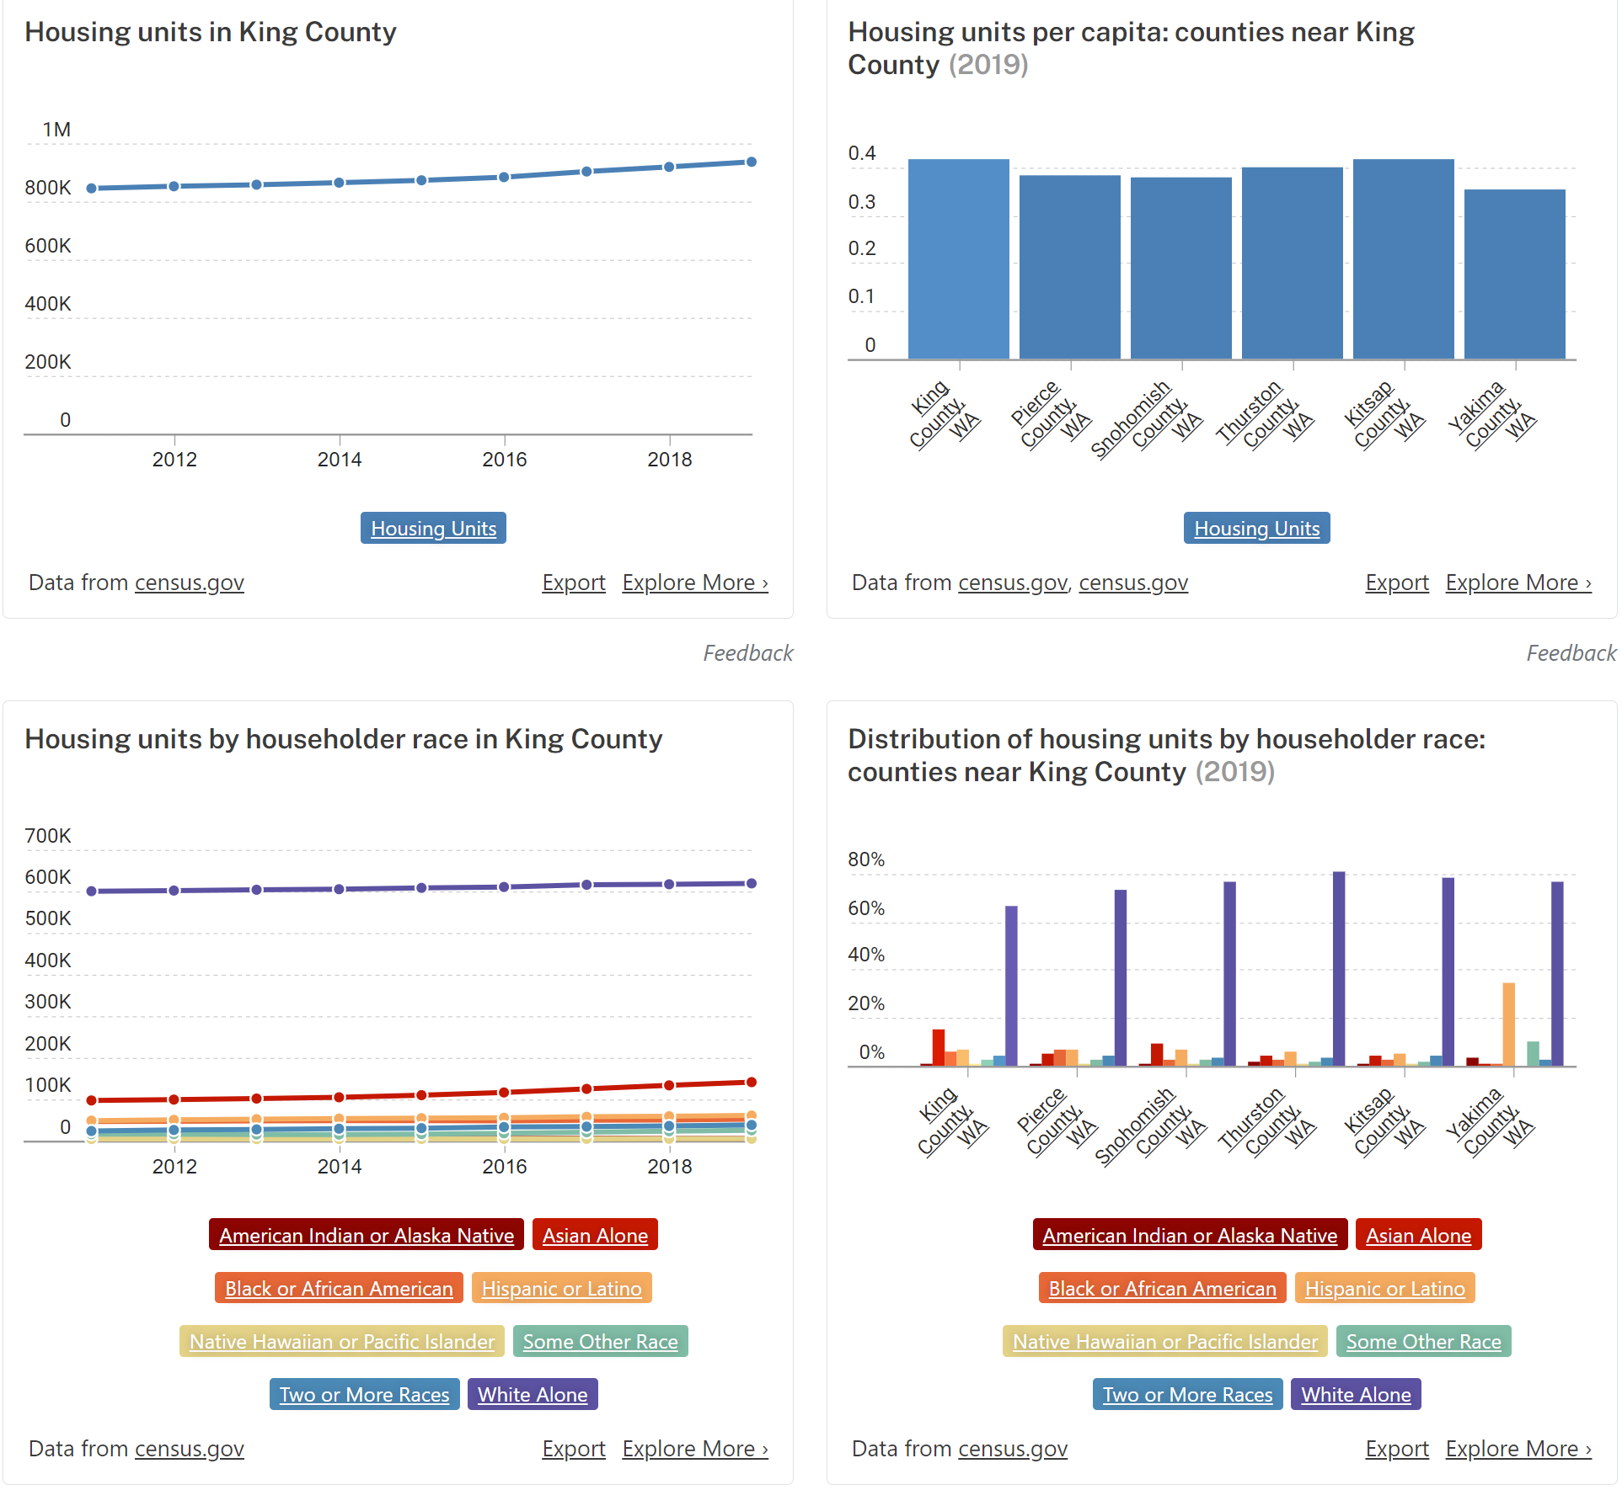
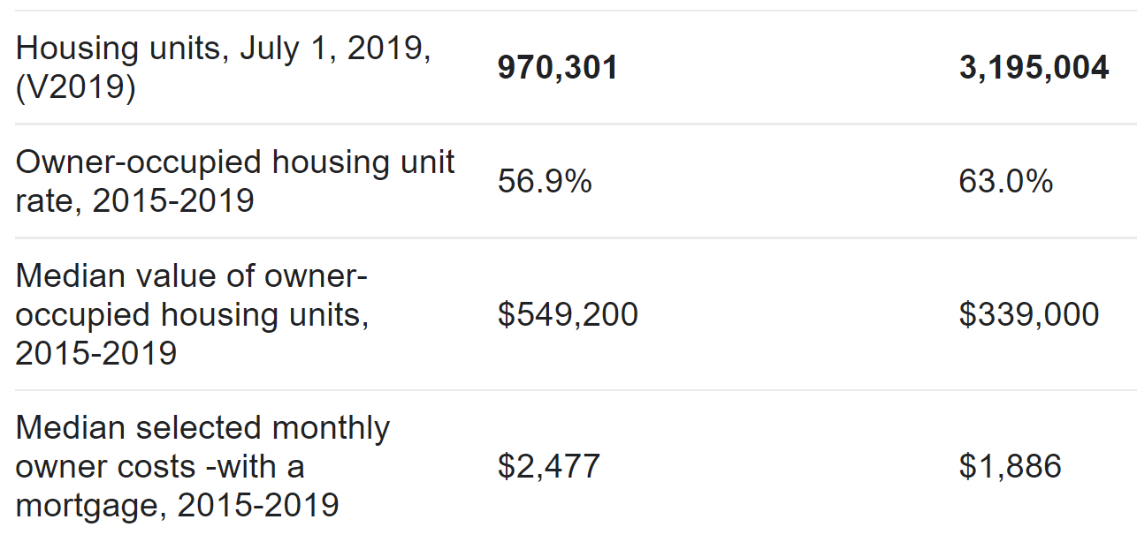
More information w.r.t housing in king county

Slide 6

Business problem understanding
OBJECTIVE
To collect the data and additional parameters that may contribute some value in deciding the price of the house.
Build a system that analyses all the input features and predicts the price of the house.

Slide 7

Business problem understanding
SCOPE
w.r.t seller
w.r.t buyer
Eliminate agent brokerage
Build a central system containing all the data and develop an interactive website and mobile application.

Slide 8
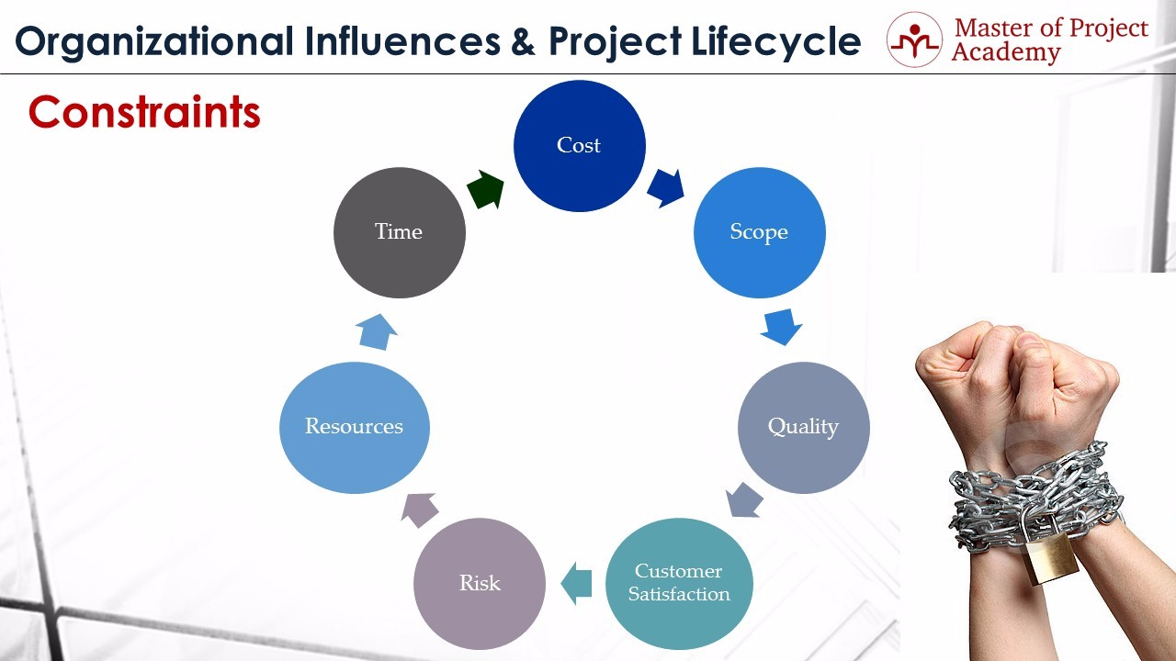
Business problem understanding
constraints
Outliers
Missing data
Cost of data collection
Time to make the system live
Updating resources and data when sold

Slide 9
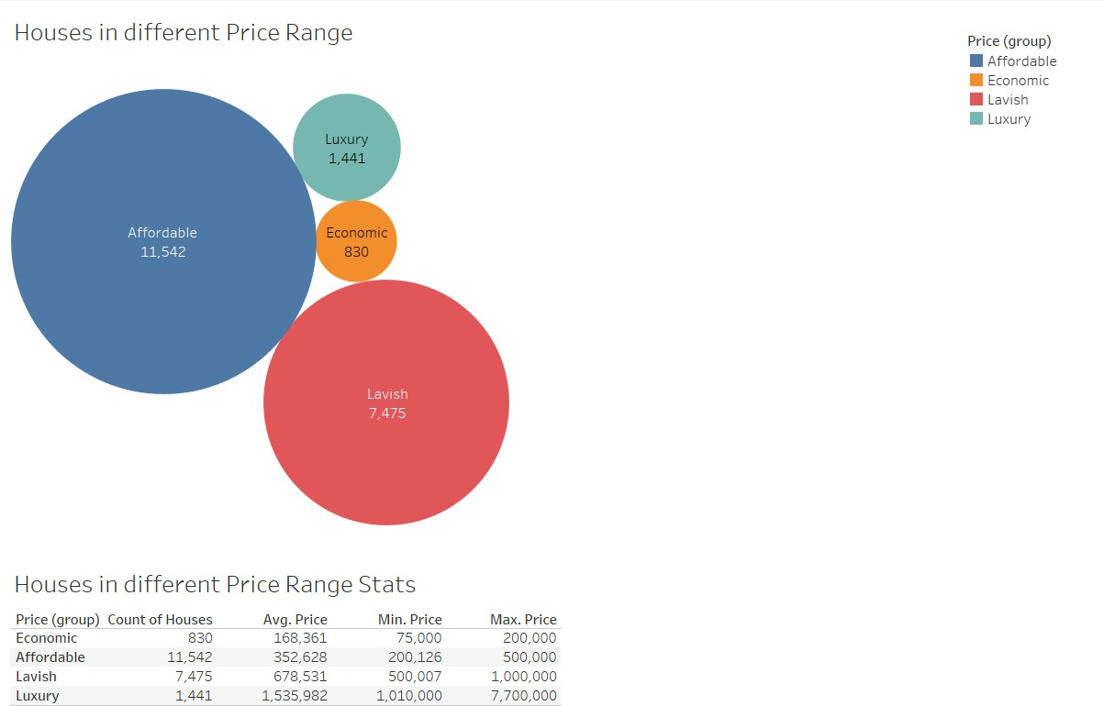
Exploratory data analysis summary
We have made 4 clusters to group houses by prices and we can see the distribution.
From the EDA we did , following were our derivations : -
House Conditions, Quality Ratings, Furniture, #Bedrooms, Sea View, Sight, Renovated, Total Living Area and Property Area have a direct influence in the price variation.
Few houses – Renovated & Sea View
Most of the variables have outliers but they don’t need to be treated.
Plot area and Total Property area have High correlation.
Some variables don’t add direct value to the analysis

Slide 10
DATA Assumptions and transformations
Assumptions
Transformations
cid doesn’t add value , so we delete it.
Outliers are genuine , so we don’t treat them.
Variables with high correlation hinder the model, so they were removed.
Data collected is correct.
House sold date is converted to year sold.
Data with $ were converted to nulls and we imputed values using knnimputer.
Basement area and renovated year converted to meaningful variables.
Missing value treatment.

Slide 11
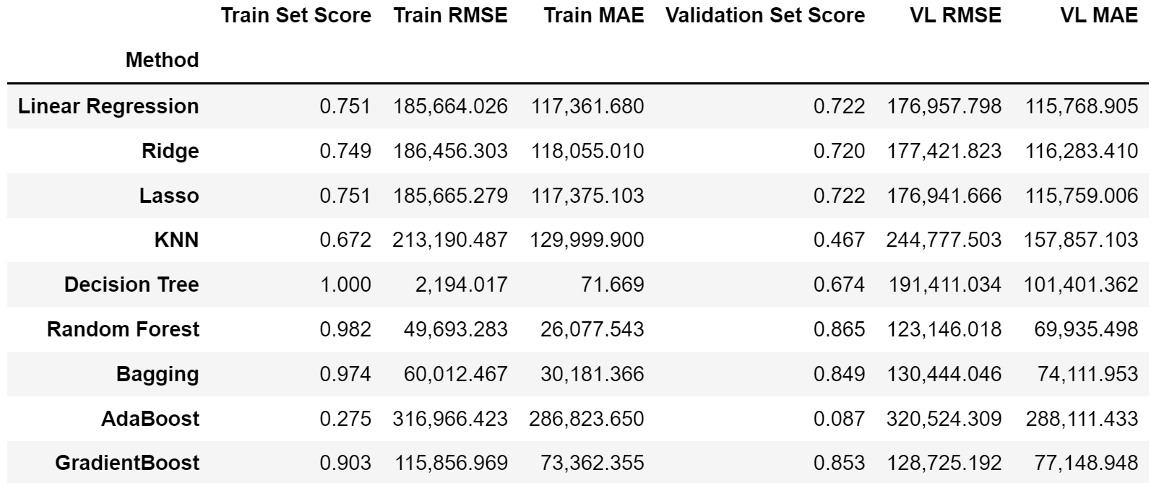
Model building The process of modeling means training a machine learning algorithm to predict the labels from the features, tuning it for the business need, and validating it on holdout data
Split train and test sets in proportion 80 : 20 respectively and further split training set into train and validation set in proportion of 80 : 20 again.
Different models used in the regression problem are: -
Linear regression
Ridge regression
Lasso regression
Knn regressor
Decision tree regressor
Ensemble techniques-
Random forest regressor
Bagging regressor
Adaboost regressor
Gradient boost regressor

Slide 12
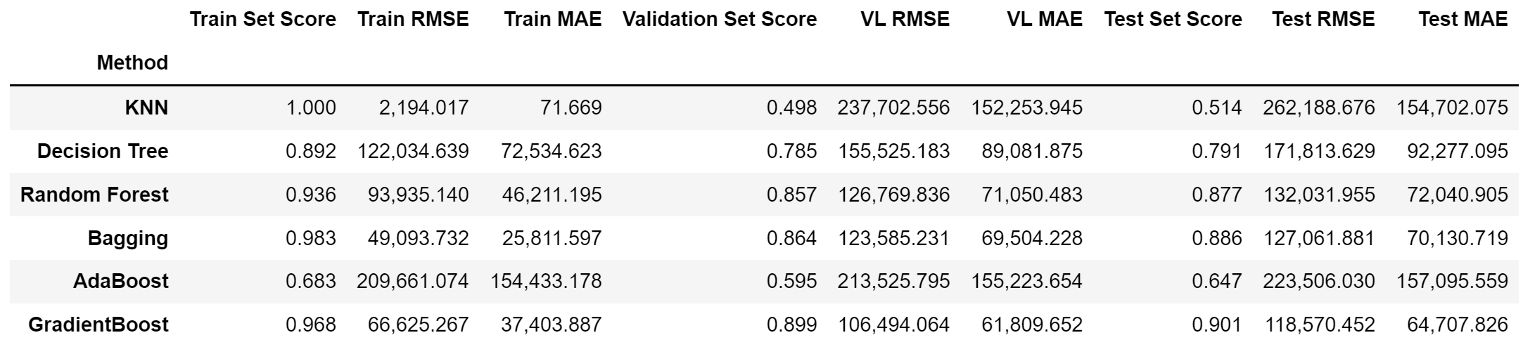
MODEL tuning
Since the ensemble techniques were doing better than the linear regression, we tuned the models based on ensemble techniques and tried to experiment with decision tree and knn and check performance on validation and test set.
As expected, ensemble methods had even better performance when model parameters were tuned.

Slide 13
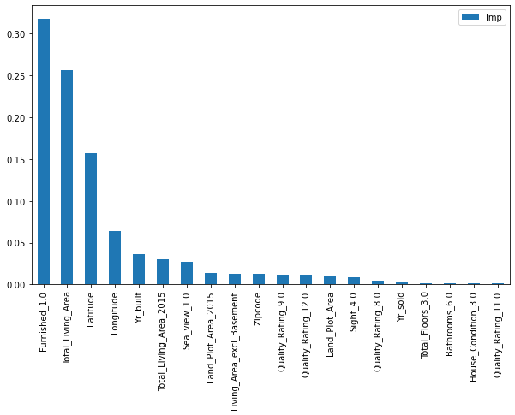
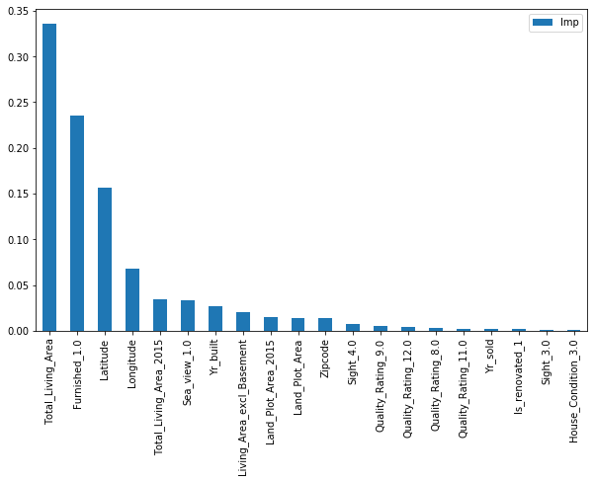
20 Important features in different models
Linear Regression using Coefficients
Using feature_importance
Decision Tree
Random Forest

Slide 14
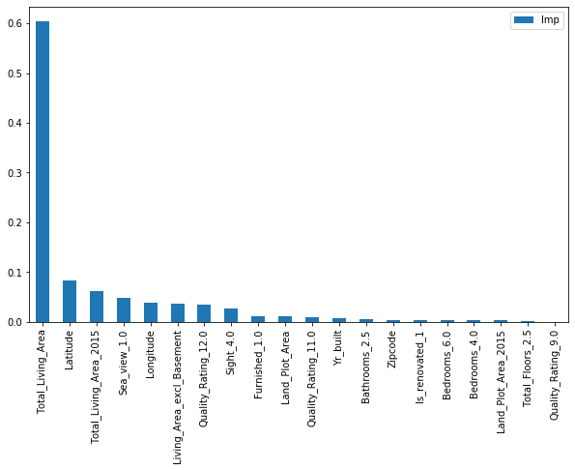
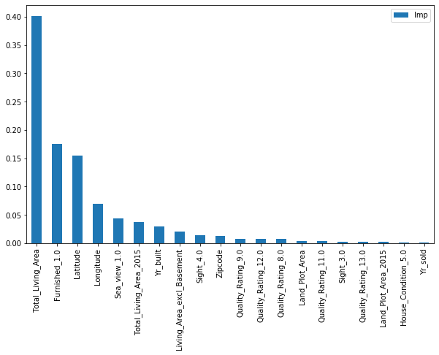
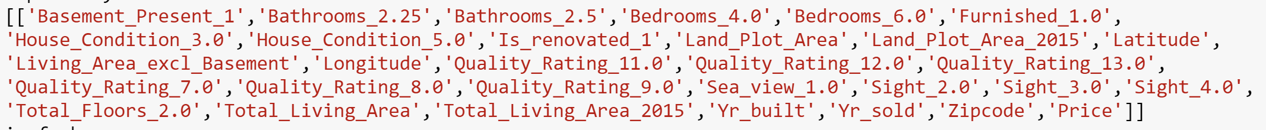
20 Important features in different models
Using feature_importance
Ada Boost
Gradient Boost
Common Features

Slide 15
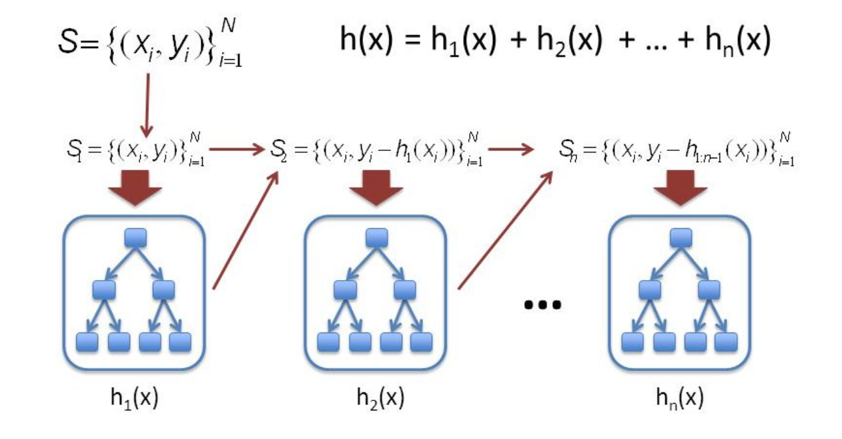
Model approach used
The linear regression models do well but their performance is not up to the mark, they have reasonably higher rmse and low r2 scores.
Ensemble techniques do pretty well and hence we tune them and Based on the model performances, we can conclude that Gradient Boosting is the most optimal model with the least RMSE and best r2 score of around 90% on the test set.

Slide 16
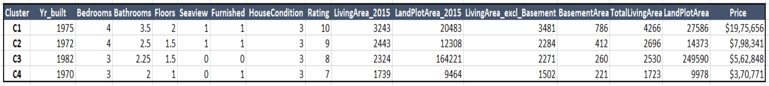
Insights and inferences
Quality Ratings, House Conditions, Furniture, Renovations, Sea View and the Location of the house were the major contributors apart from the #Bedrooms and house, plot and property areas.
About 10-15% population live in the extreme (poor or rich) where as around 85% live in houses between 200,000 $ and 1,000,000 $.
Only ~1% houses had a sea view and ~4% houses were renovated. Around 70% houses had a House Condition of 3.0 and had Quality Rating of 7 or 8.
Clusters made on House Pricing Category(Luxury, Lavish, Affordable and Economic)-

Slide 17
Recommendations and business scope
Collect the data of houses sold and bought for the last 5 years and feed the data to the system.
Develop interactive website and mobile application for the same.
Plan online marketing campaigns as “brokerage killers” and “Best Houses at Right Price”.
Target the right audience.
We can tie-up with the state for making this service a public service and charging a royalty and maintenance fee.
Timely updates and model optimization.
Build models for renting apartments and leasing properties.
Integrate with financial agencies that provide loans and ease of money transfer wallets.

Slide 18
Thank you
Submitted by-
Aaditya Desai

